Slide 2
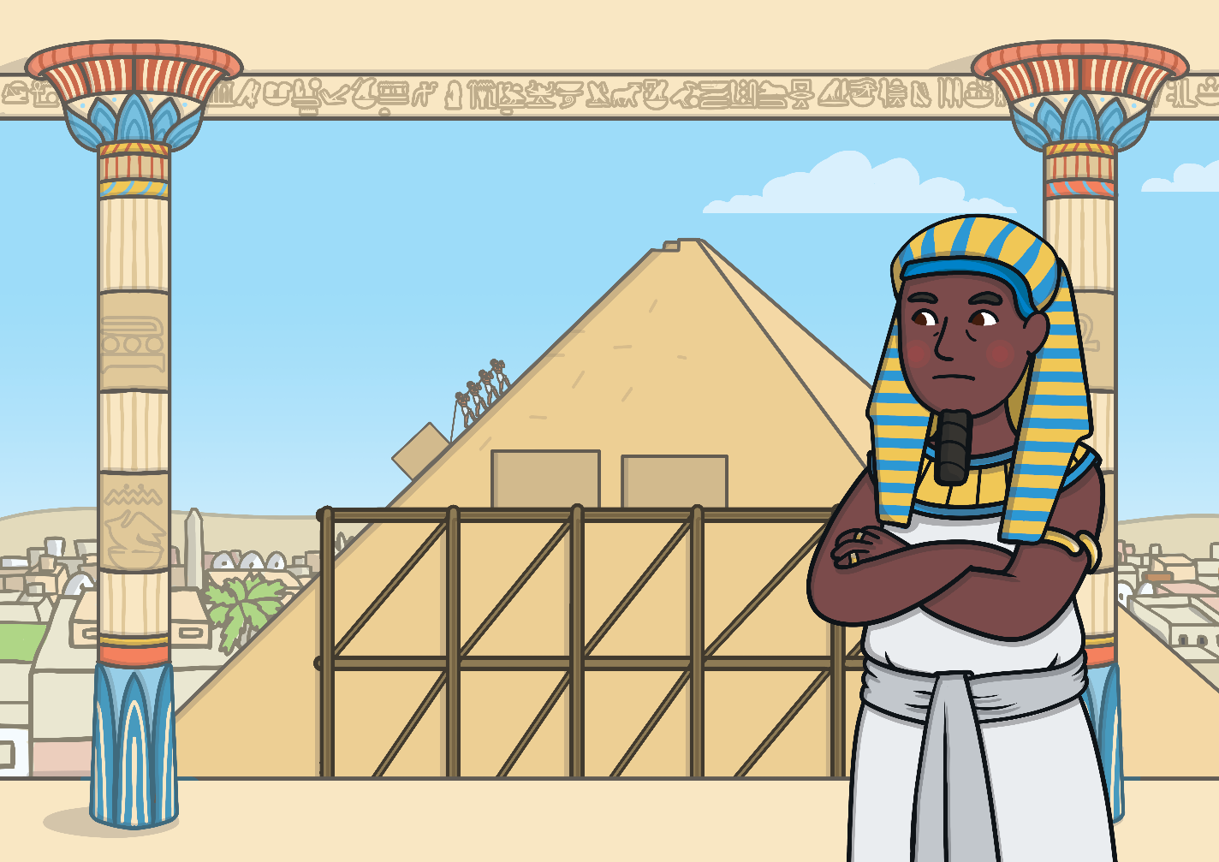
When Moses was born, the Israelites were enslaved in Egypt. The Pharaoh was afraid of them because he thought they might take over his country.
He ordered his soldiers to kill all the baby boys at birth so they would not grow up and fight him.

Slide 3
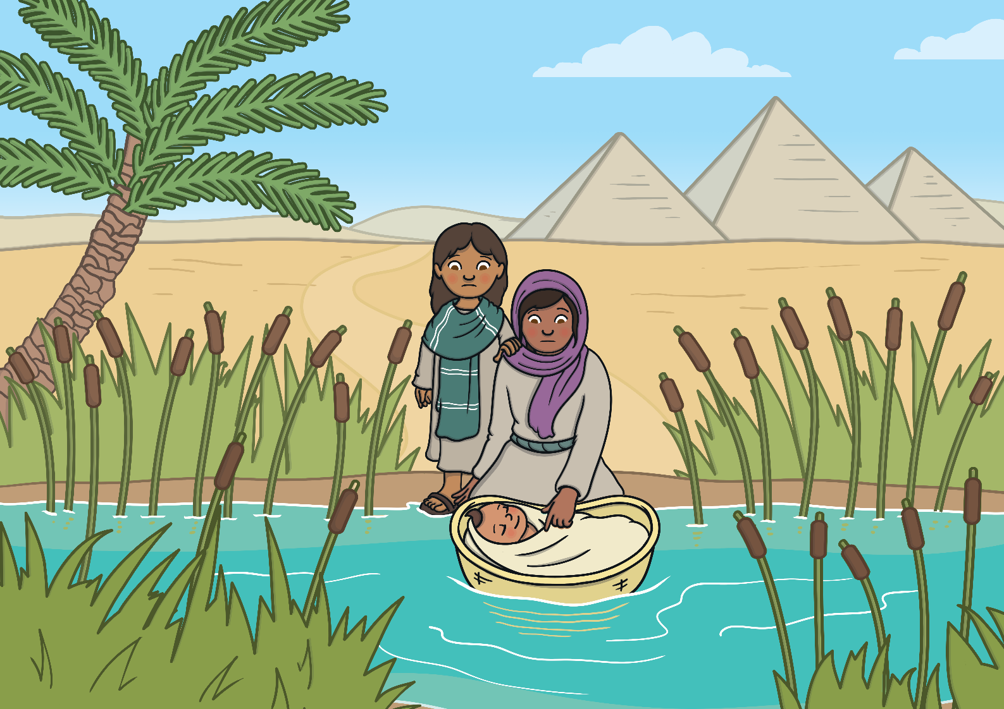
To save Moses, his mother made a plan. She put him in a basket and set him adrift on the River Nile and left his fate to God’s will.

Slide 4
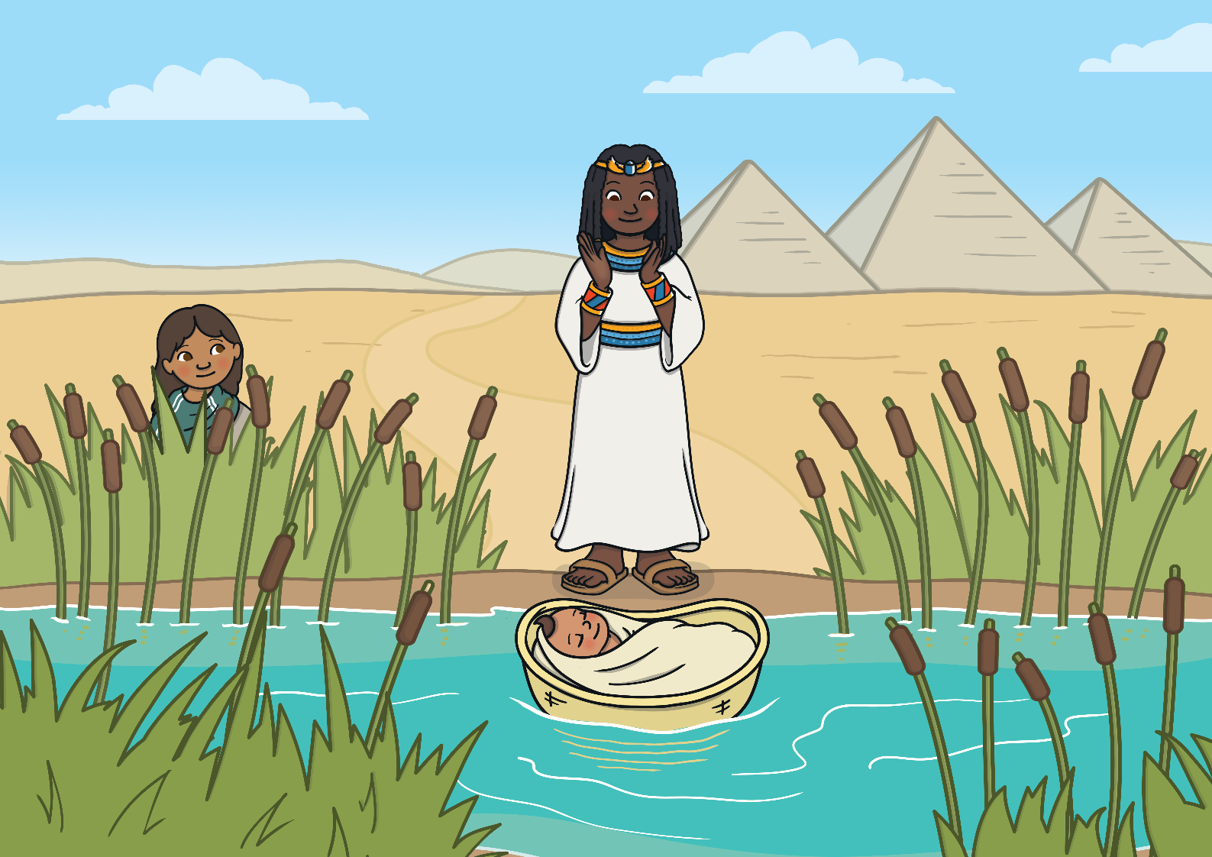
Moses floated down the river where the Pharaoh’s daughter found and rescued him. She brought him back to the palace and raised him as a son.

Slide 5
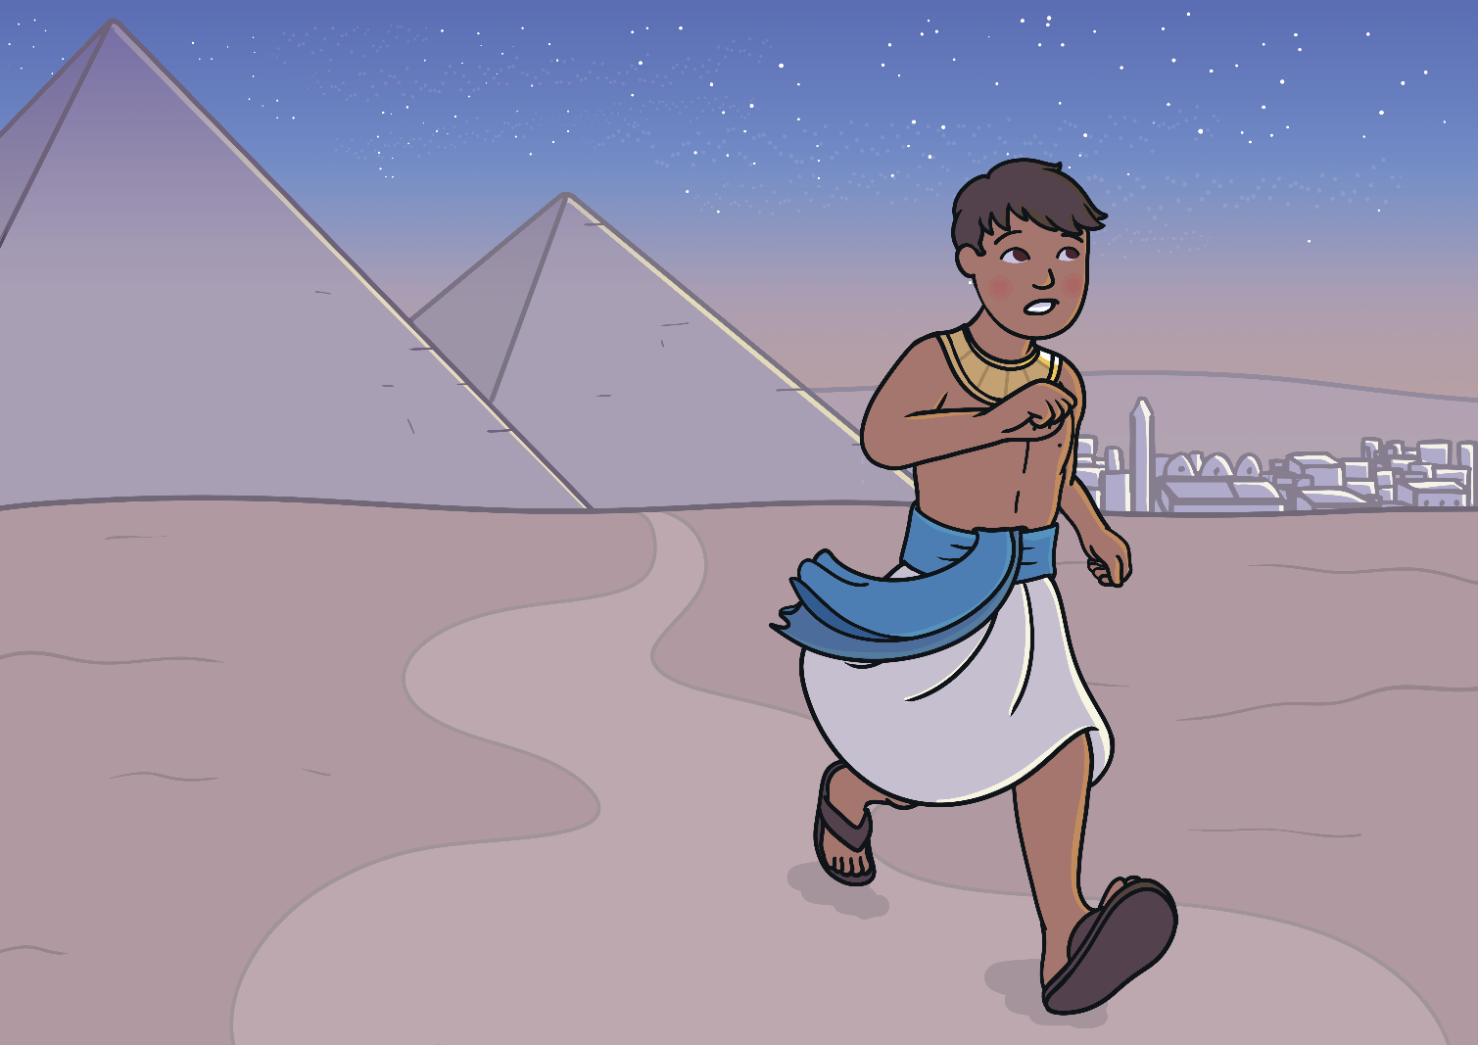
Moses grew up in the palace as a royal prince. One day he lost his temper and killed an Egyptian who had beaten an enslaved Israelite to death.
He had to flee to another land called Midian.

Slide 6
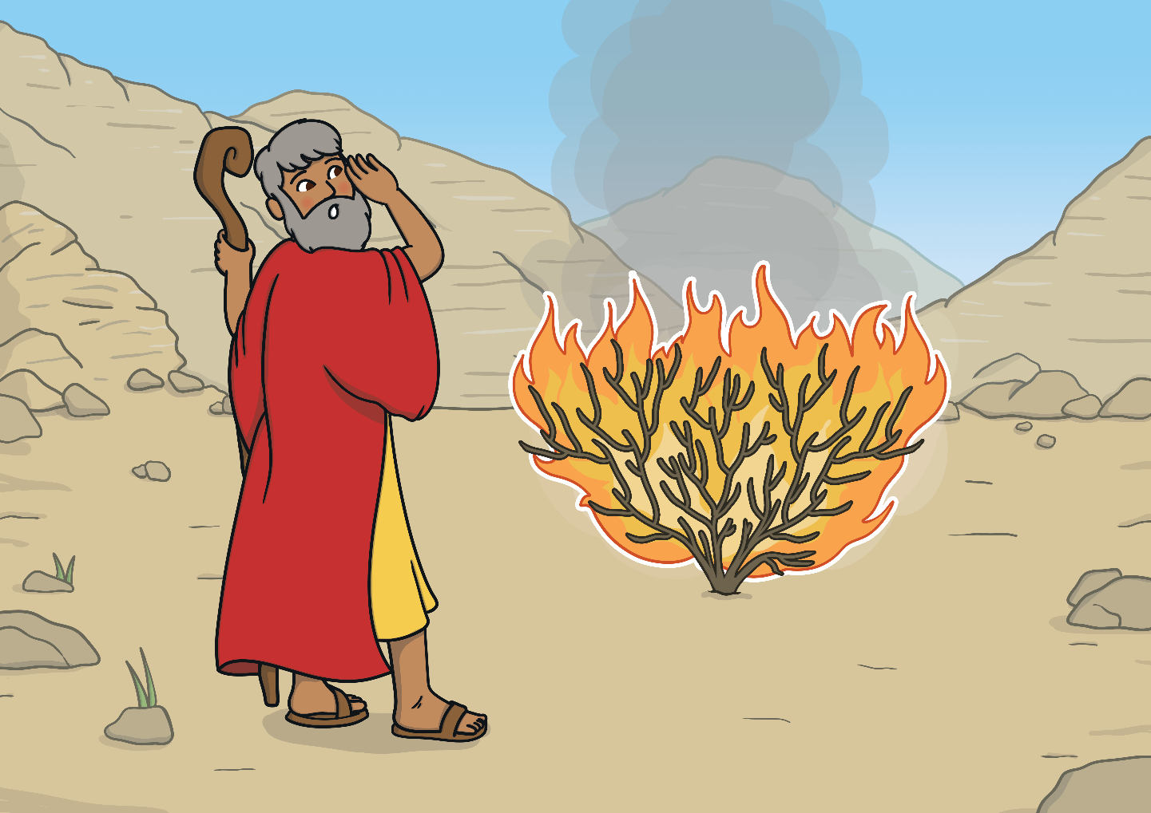
Moses lived in the land of Midian and worked as a shepherd for forty years. One day, in the desert, he heard the voice of God from a burning bush.
God asked Moses to lead his people out of enslavement in Egypt to the Promised Land. His brother, Aaron, promised to help him.

Slide 7
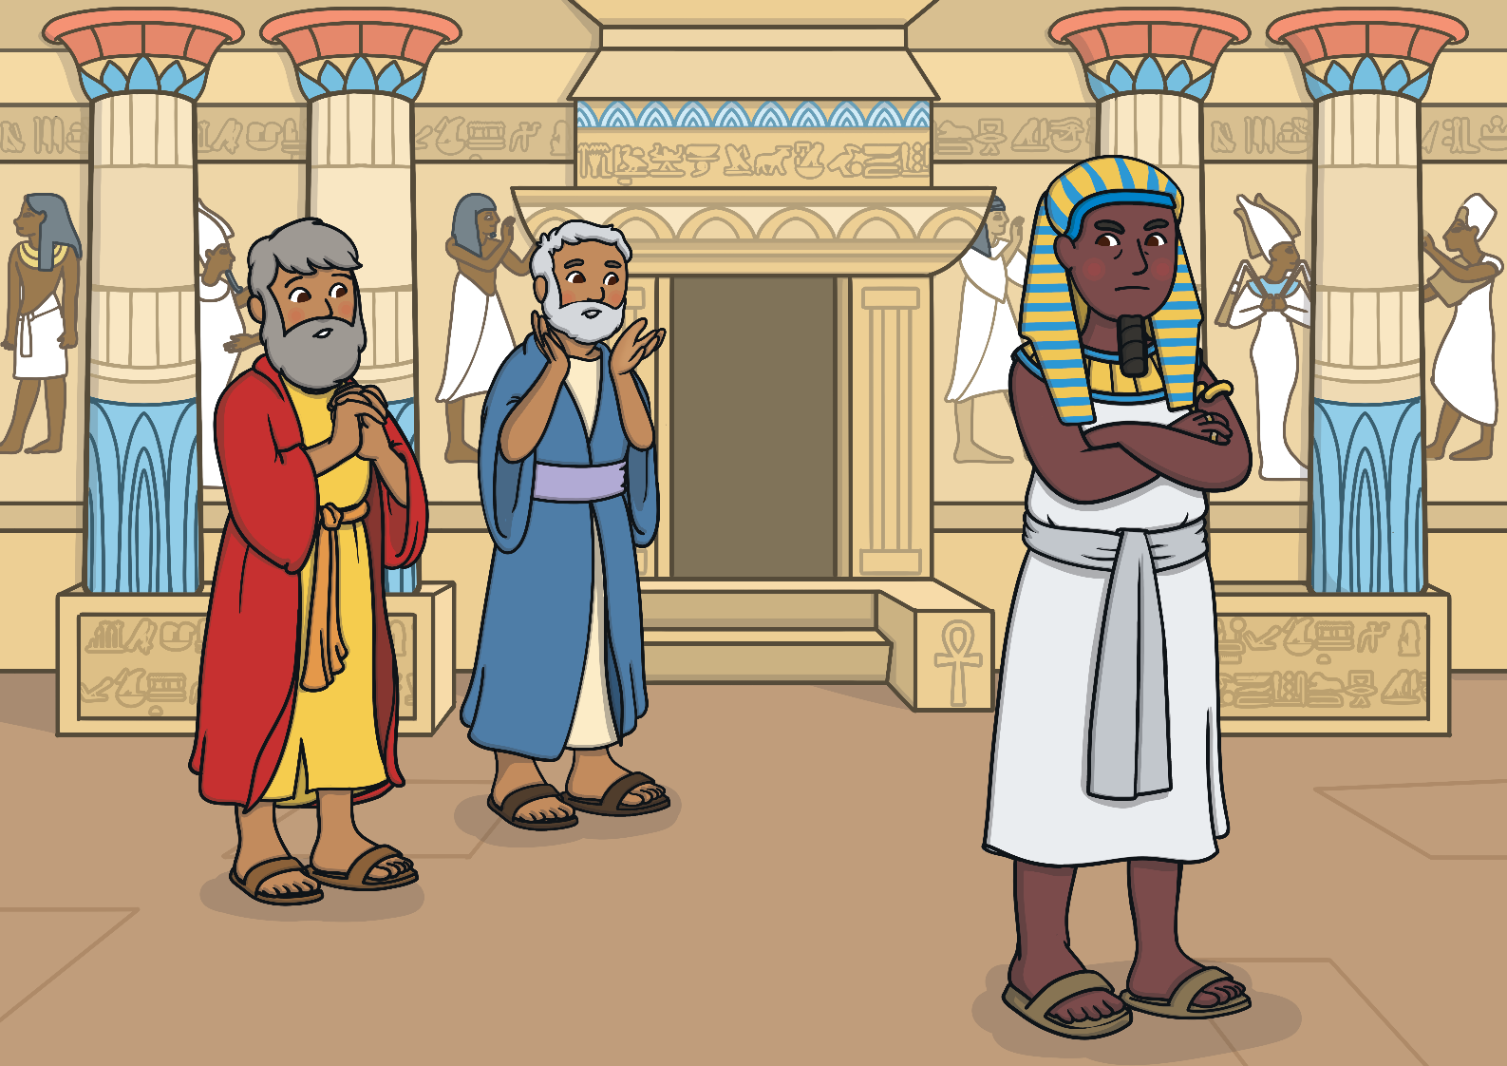
Moses and Aaron went back to Egypt and asked the Pharaoh to free his people. The Pharaoh did not want to lose his enslaved Israelites so he refused.
God was angry and unleashed ten plagues on the Egyptians.

Slide 8
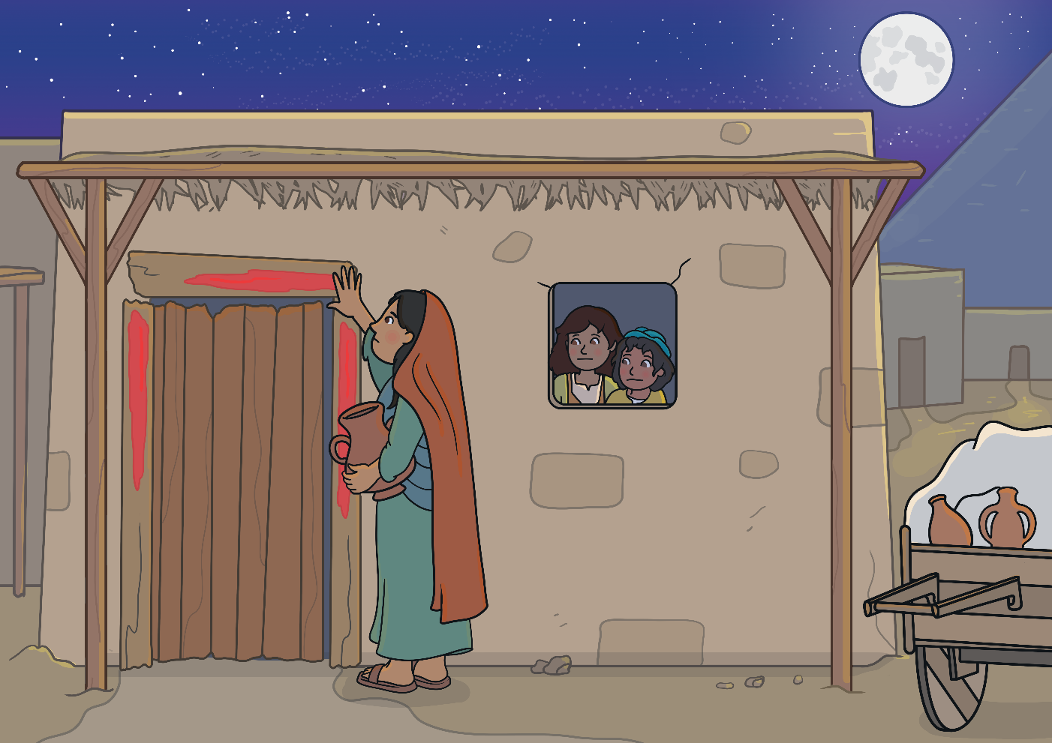
It was the tenth plague that finally made the Pharaoh let them go. The eldest son in every family, including the Pharaoh’s, died.
The Israelites marked their doorposts with lamb’s blood so that they would be safe. God could ‘pass over’ their houses and spare them. This is why the celebration is called Passover.

Slide 9
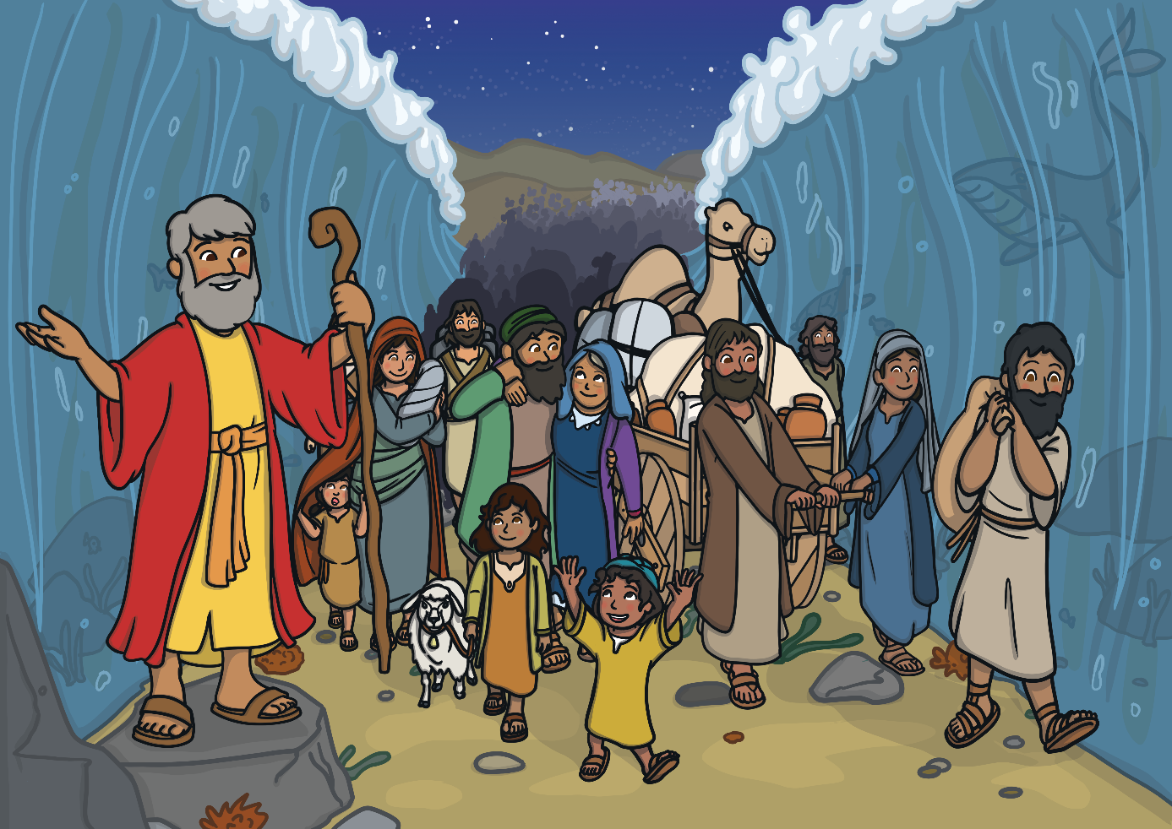
The Israelites fled but soon after the Pharaoh changed his mind and sent his army after them. The army chased the Israelites to the banks of the Red Sea where they were trapped.
God told Moses to lift up his rod and as he did so the waters parted to make a dry path.

Slide 10
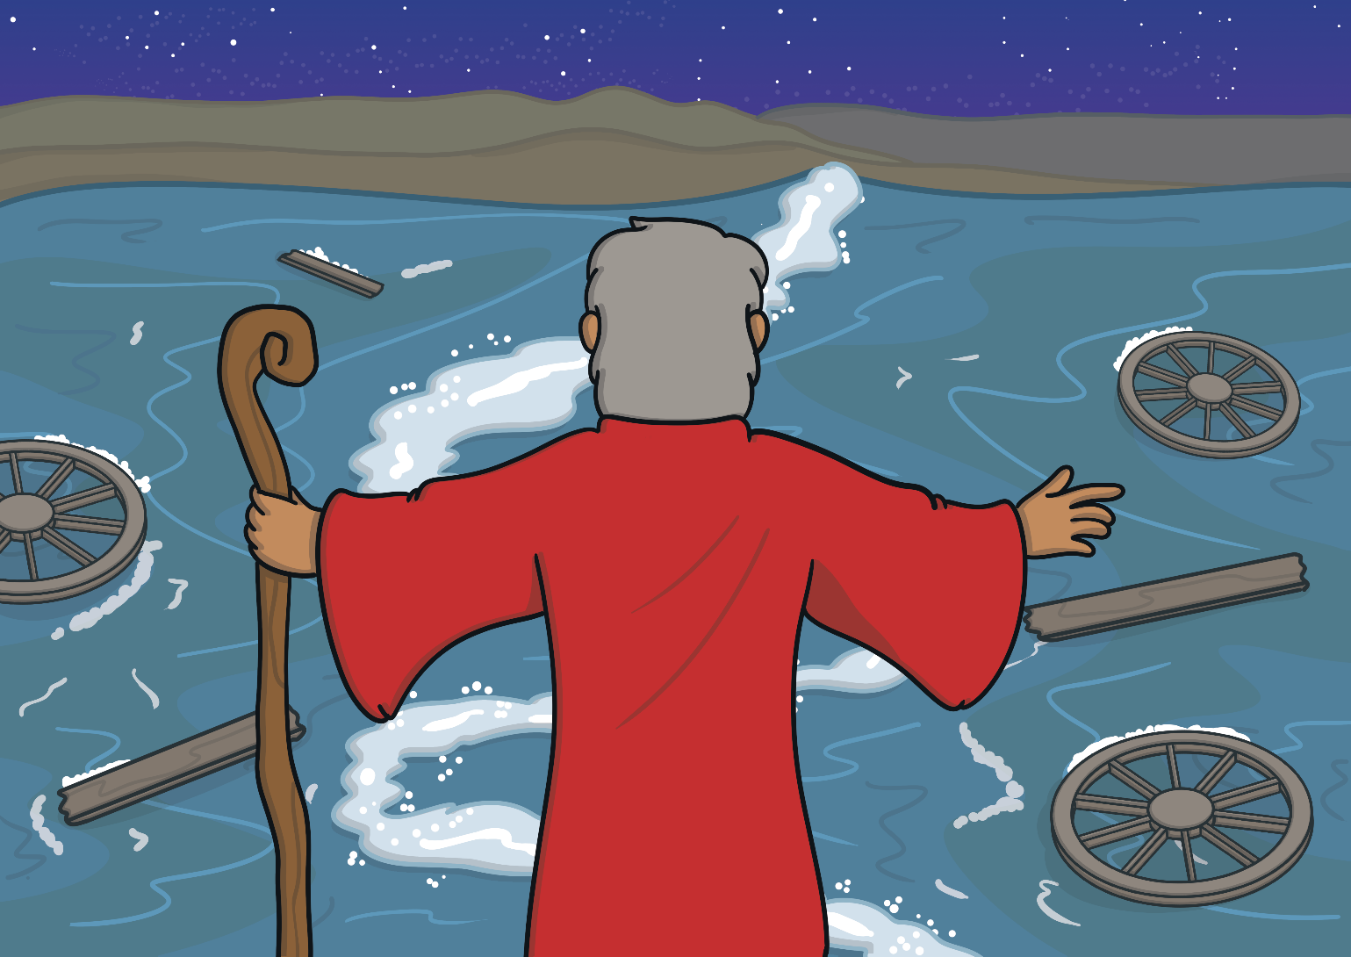
When all the Israelites were safely at the other shore, Moses raised up his rod again and the water closed on the Pharaoh’s army who had been chasing them. God had saved the Israelites once more.

Slide 11
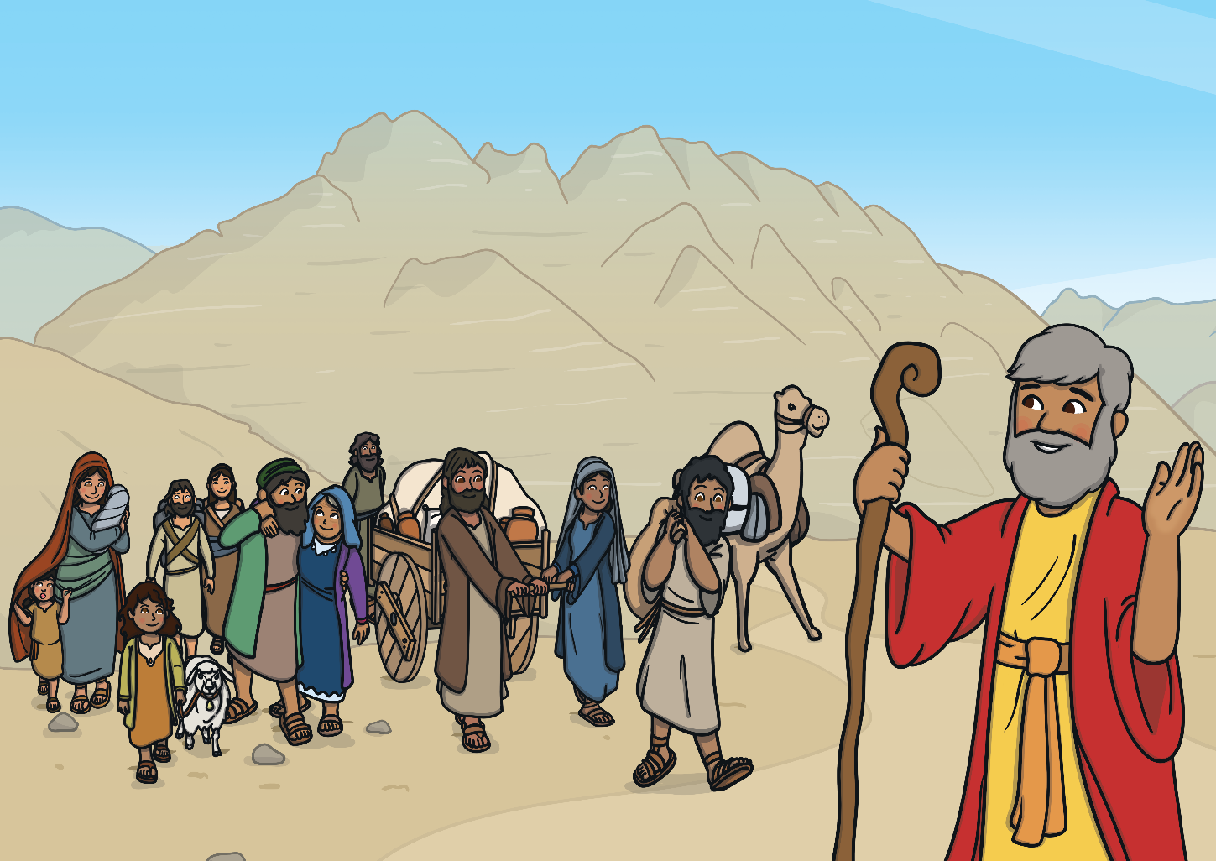
The Israelites were free but they still had nowhere to live. They were searching for a land called Canaan, which they had been promised by God.
The journey was long and they were hungry. Moses promised that God would provide food.

Slide 12
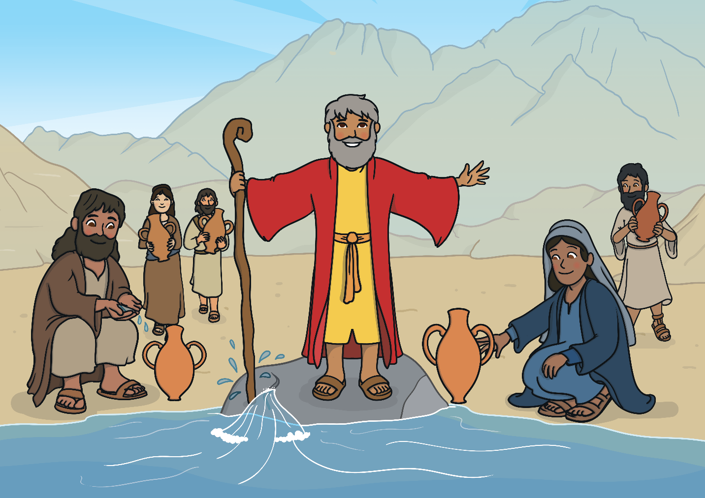
To their amazement, the next day they woke up to discover that the ground was covered with white food that tasted like honey.
When their water ran out, God told Moses to strike a rock with his rod. As he did this, water ran out and they were all able to drink.

Slide 13
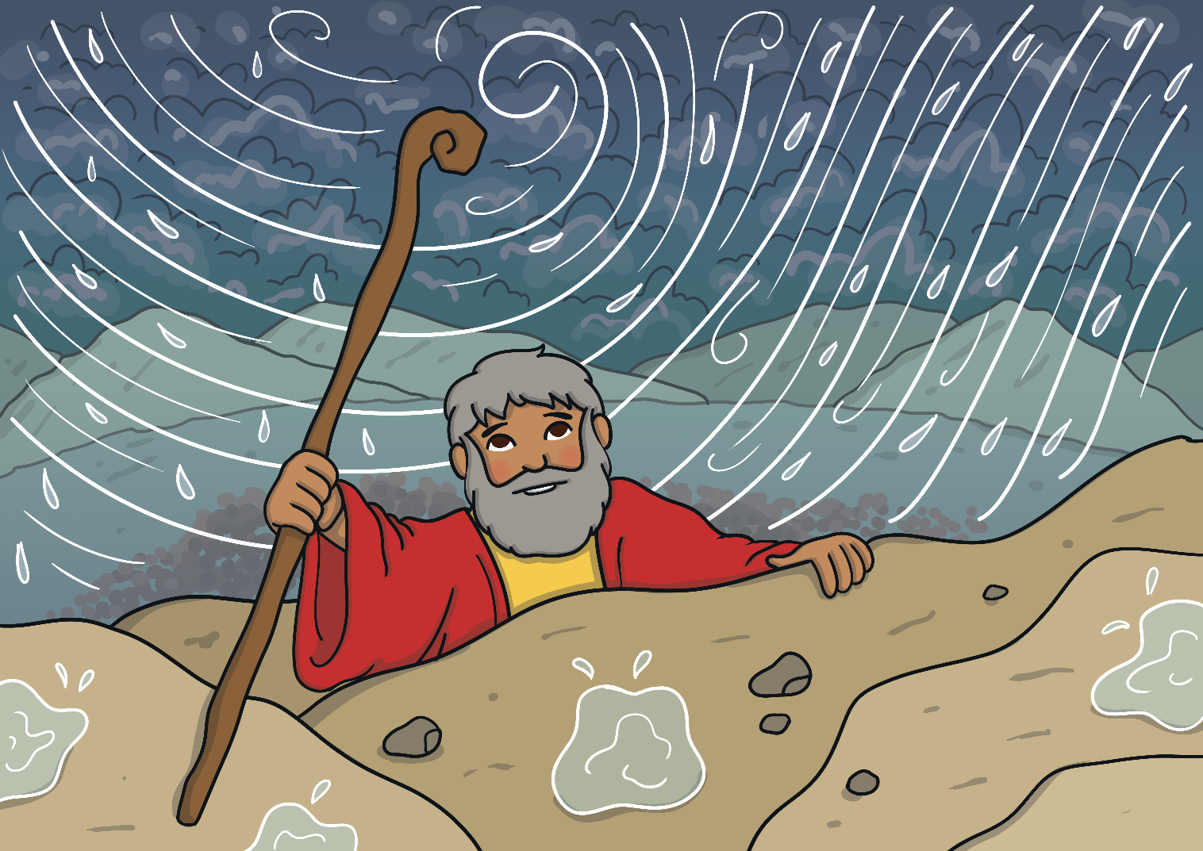
After three months of travelling, the Israelites arrived at the foot of Mount Sinai, where God called Moses to meet him at the top of the mountain.
Moses had to climb the mountain in a thunderstorm.

Slide 14
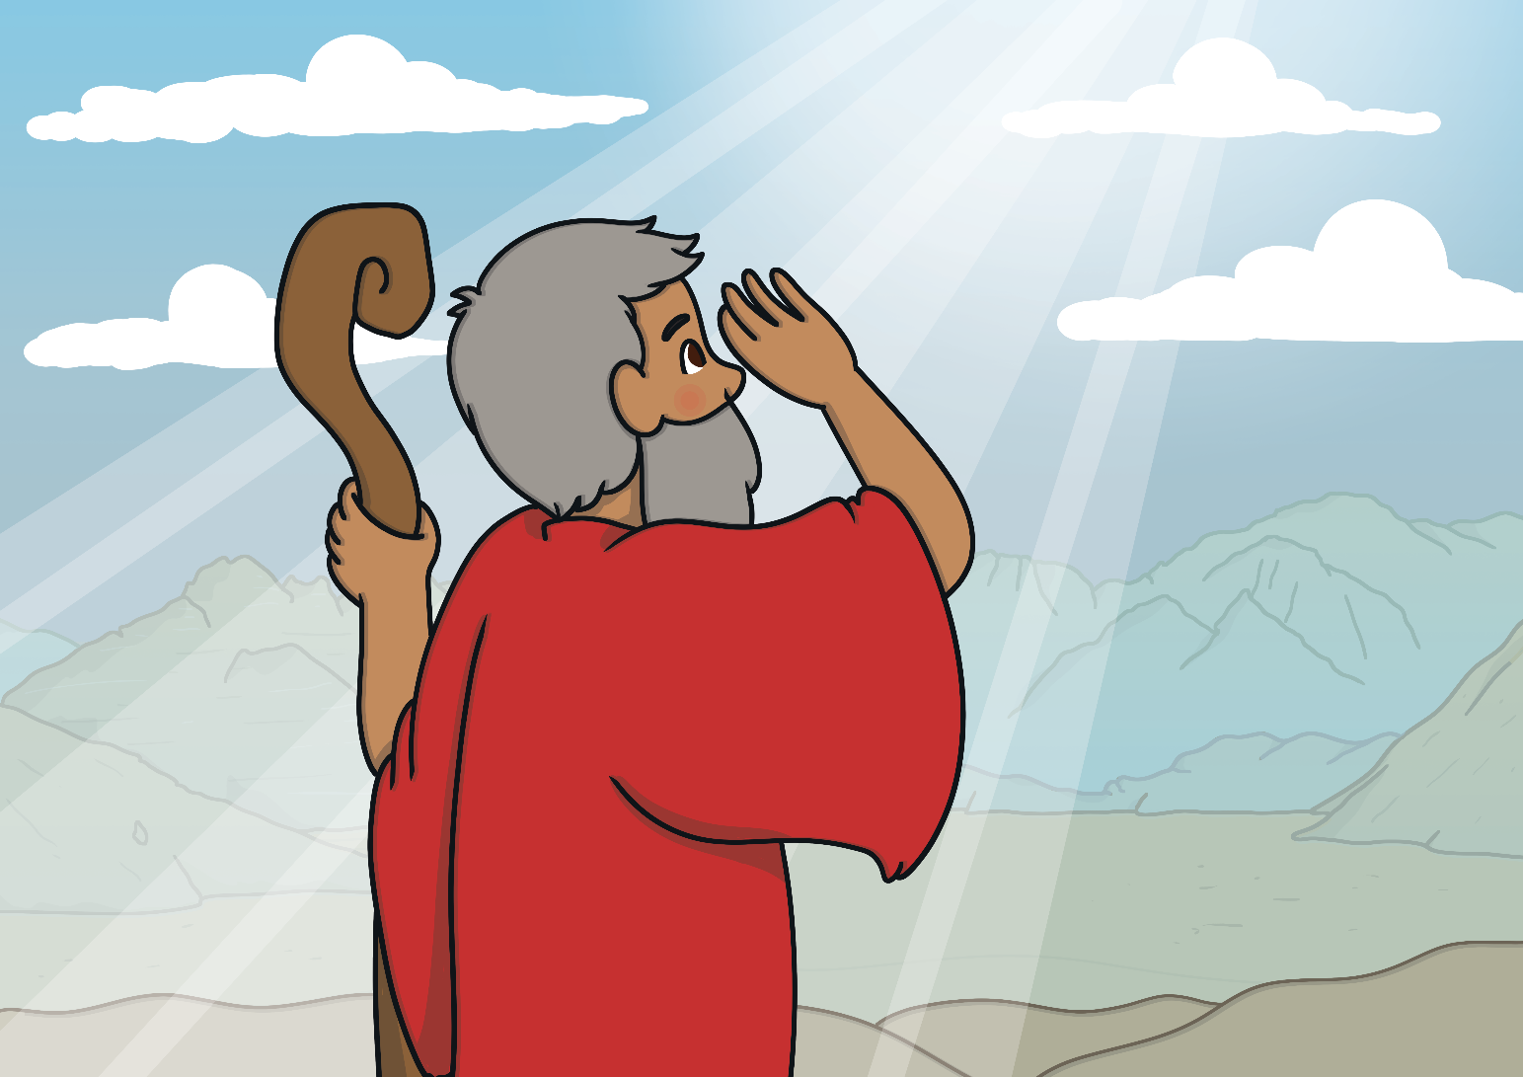
At the top of the mountain, God gave Moses ten important laws. These laws were called the Ten Commandments and would tell the people how to live.

Slide 15
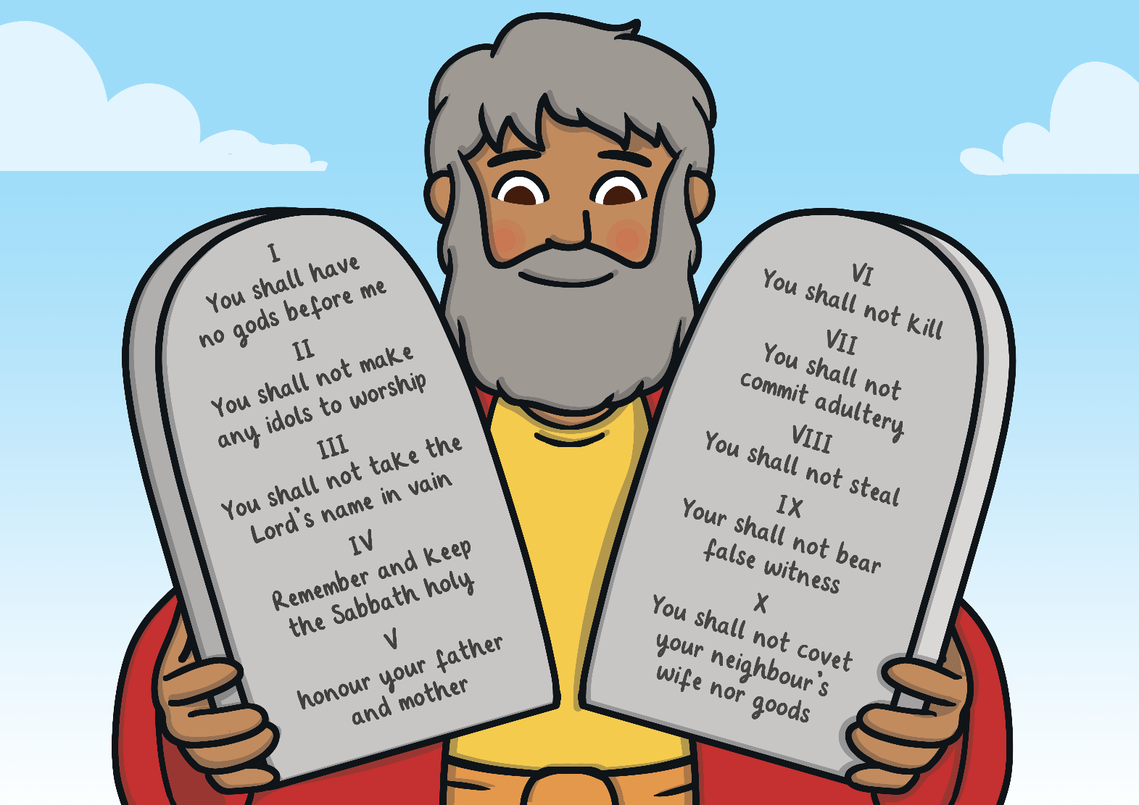
Moses promised God that the Israelites would keep all of the Ten Commandments.

