Slide 1
History
Crime and Punishment
Year One
History | LKS2 | Crime and Punishment | Through the Ages | Lesson 5

Slide 3
Aim
I can reflect on what I have learnt about the history of crime and punishment in Britain.
I can compare modern methods of crime and punishment and detection with what existed in the past.
Success Criteria
I can recall key facts about crime and punishment in Britain from the Roman, Anglo-Saxon, Tudor and Victorian periods.
I can write about what I have learnt about the history of crime and punishment in Britain.
I can talk about modern crime prevention and detection methods that we have now.
I can compare these modern methods with what was used to prevent and detect crimes in the past.

Slide 4
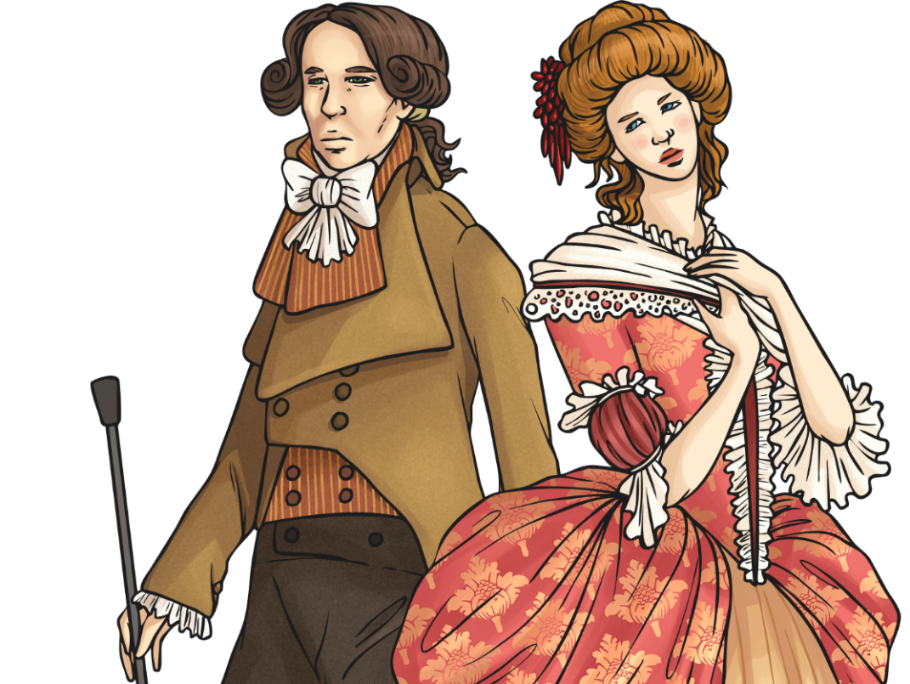
Crime and Punishment Timeline
The Romans
The Vikings
The Plantagenets
The Stuarts
The Victorians
43
450
793
1066
1154
1485
1603
1704
1837
The Anglo-Saxons
The Normans
The Tudors
The Georgians
Activity
What can you remember about the crime and punishment that existed in some of these historical periods?
Look at your activity sheet. Cut out the words and place them on the period you think it relates to.

Slide 5
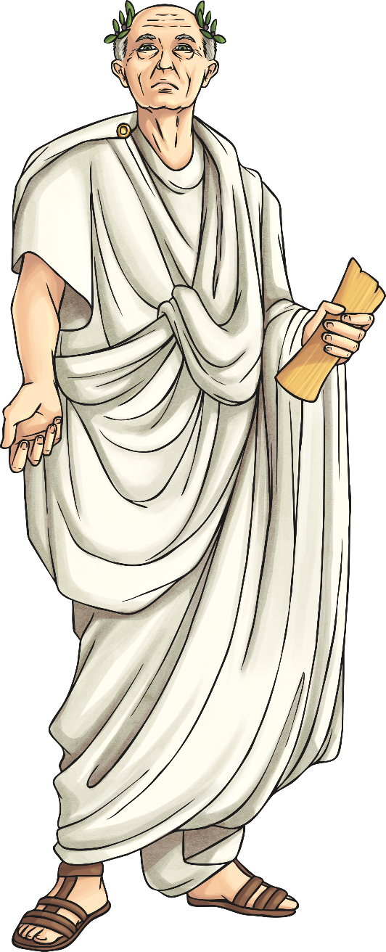
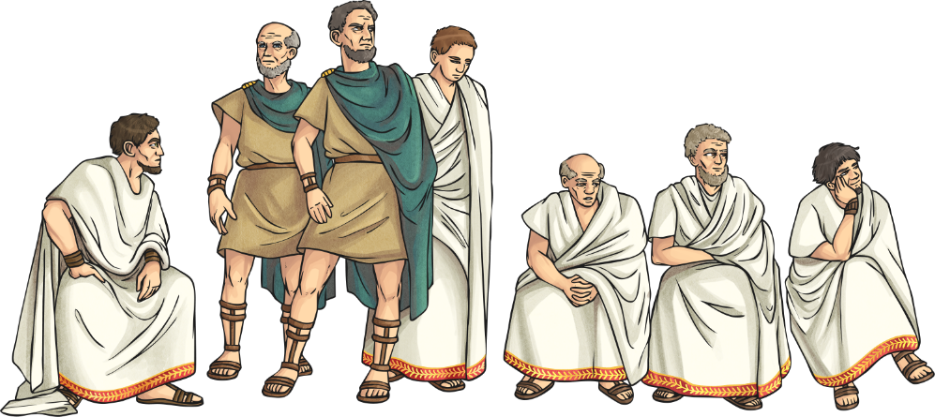
Crime and Punishment Through the Ages The Romans
Punishments would be very harsh to try to stop people from committing a crime in the first place. If you had money however, you could pay to have your punishment lessened. If you were a slave, you had no rights at all. The worst crime was considered to be rebellion against the emperor.
The Romans introduced their laws that were called the Twelve Tables, that were written around 450 BC.
People accused of committing a crime were taken to court to be judged guilty or not guilty. If it was a serious crime, a jury would decide whether they were guilty or not. If it was a minor crime, the judge would decide. The job of finding a criminal was the role of the legionaries.

Slide 6
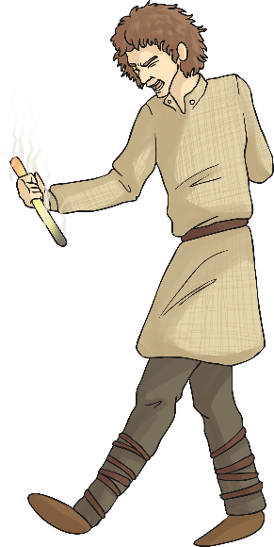
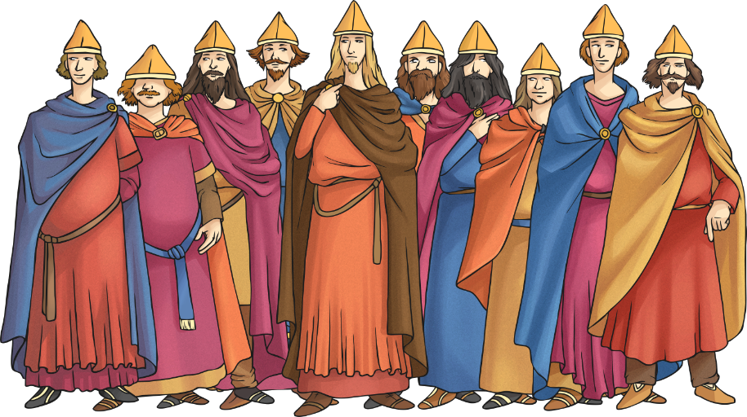
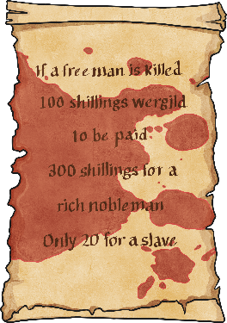
Crime and Punishment Through the Ages The Anglo-Saxons
The Anglo-Saxons also used very harsh punishments to stop people from committing crimes. Punishments ranged from hanging, branding and whipping to trials by ordeal.
Communities were divided into groups of 10 men, that were called tithings. These men were responsible for each other’s behaviour. When a village needed to find a criminal, they would call upon all of the community to find them – this was called a hue and cry.
If the person accused of the crime could not find enough oath-keepers (to say that they were innocent of the crime) then they may face a trial by ordeal. Anglo-Saxons believed that through these trials, God would decide whether the person was guilty or not.
A common way to solve disputes between a victim’s family and a criminal was through payment called wergild. Wergild would be paid to the family if someone was killed or injured.

Slide 7
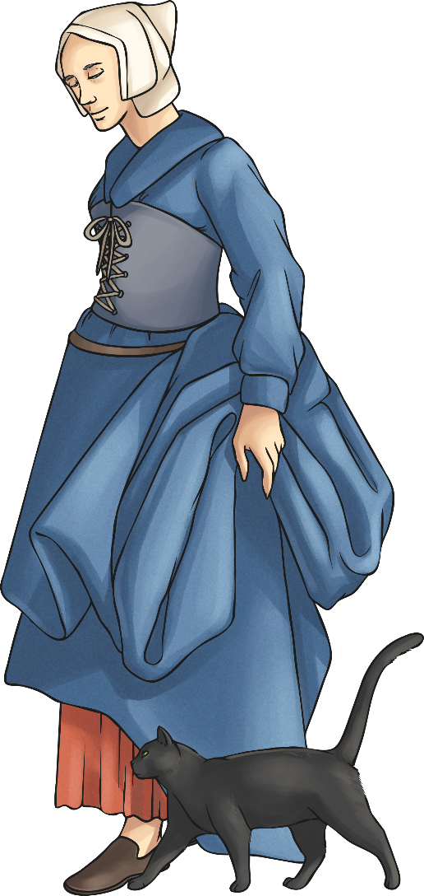
Crime and Punishment Through the Ages The Tudors
The Tudors brought in even more terrifying punishments than ever before. The Tudor kings and queens were very worried about treason – people plotting against them – and so punishments for that were extremely severe. Public executions were very common, especially during the time of Henry VIII.
Some of the following punishments were often used during the Tudor period. Women could be punished for ‘gossiping’ by wearing a scold’s bridle – a piece of equipment that was placed over the head and would hurt the tongue if it moved.
If a woman was thought to be a witch, she would be tied to a ducking stool and lowered into water. If she floated, she was considered a witch and would be killed. If she drowned, she would be thought innocent but it would be too late for the poor woman!
If they had been causing a local nuisance, some men would have to wear a drunkard’s cloak – a large barrel that restricted movement – and walk around their village.

Slide 8
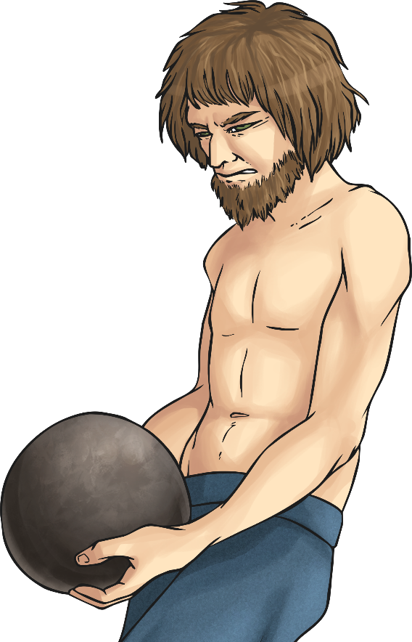
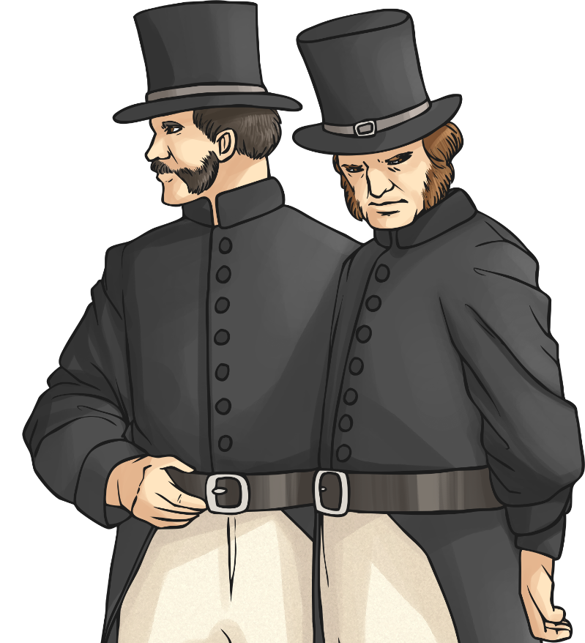
Crime and Punishment Through the Ages The Victorians
During the Victorian period, the police force was introduced. People were becoming unhappy about hanging and so new ideas for punishment started to be used instead. Some criminals were punished by being sent to live in Australia. This was called transportation.
More prisons were built and this became the main form of punishment during Victorian times. In prison, they were forced to carry out hard labour. Some hard labour tasks included picking oakum (picking apart tarred rope), the treadwheel and the shot drill. These tasks would be extremely physically
demanding and would take place for hours at a time, so that the prisoners could earn their food for the day.

Slide 9
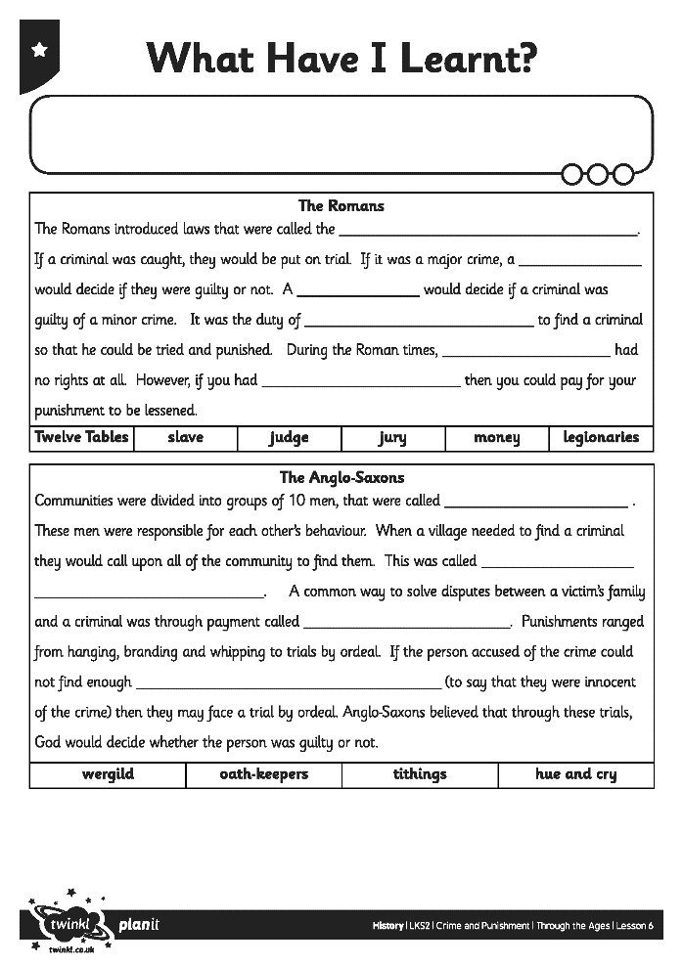
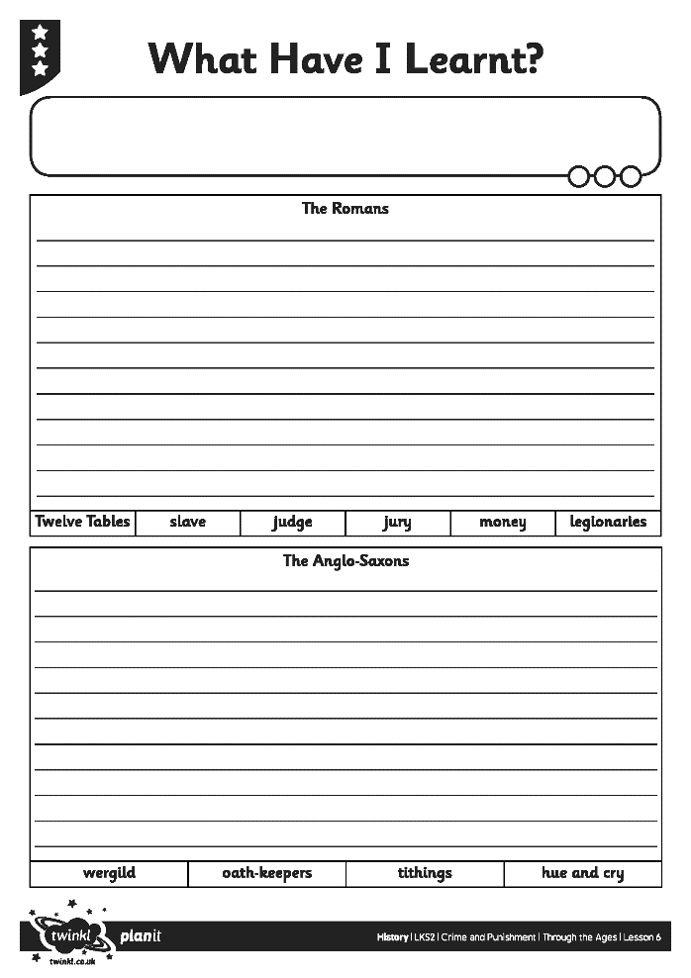
What Have I Learnt?

Slide 10
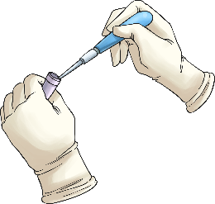
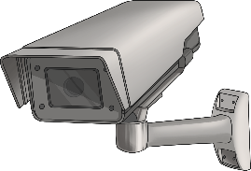
Modern Crime Prevention and Detection
Nowadays, we have many more ways to find criminals and send them to prison. We also use many methods to stop people from carrying out a crime.
Prevention – to stop something from happening.
Detection – to find out how something has happened.
Activity
Look at the different things listed on the grid.
Which ones prevent or detect crimes? Do any do both of these?
Can you think of any other things we have now that prevent crime from happening?

Slide 11
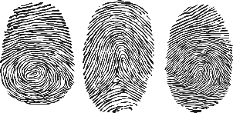
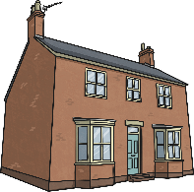
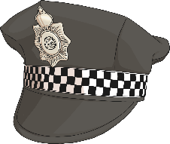
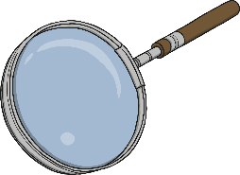
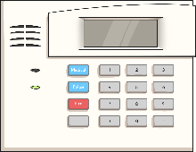
Modern Crime Prevention and Detection
Which of these things actually started in different historical periods?
DNA testing | CCTV or video footage | Use of fingerprints
Neighbourhood watch | Trial by judge and jury | Police
Witness to a crime | House and car alarms | Improved street lighting
Anglo-Saxons (tithings, hue and cry)
Romans
Victorians
Romans/ Anglo-Saxons (oath-keepers)

Slide 12
Aim
I can reflect on what I have learnt about the history of crime and punishment in Britain.
I can compare modern methods of crime and punishment and detection with what existed in the past.
Success Criteria
I can recall key facts about crime and punishment in Britain from the Roman, Anglo-Saxon, Tudor and Victorian periods.
I can write about what I have learnt about the history of crime and punishment in Britain.
I can talk about modern crime prevention and detection methods that we have now.
I can compare these modern methods with what was used to prevent and detect crimes in the past.

